Slide 1






Oversea purchasing in Sinodis
Forecasting
and
planning
Production &
Order
preparation
Loading
at supplier
warehouse
Shipment
Custom
Delivery
at Sinodis
warehouse
SINODIS
PO date
ETD
ETA
GR
Purchase order
placement
to supplier
Oversea logistic
Organization*
Issue import
documents
Provide all
documents
to prepare for CIQ
Payment
Claim
Receive
CIQ certificate
SUPPLIER
Purchase order
confirmation to Sinodis
7 days after PO date
Oversea logistic
Organization*
Issue export
documents
Send original
to Sinodis
14 days before ETA
Confirm date of loading
*logistic organization involves the forwarder (booking vessel,/flight, select shipping /airline) and the responsible (Sinodis/supplier) depends on the INCOTERM

Slide 2


Purchasing Planning in Sinodis – Lead time and product life cycle management
Total shelflife
Customer shelflife req.
PO
Order to supplier
Production
ETD
Departure date from port
ETA
China port
GR
Sinodis
WHR
CIQ
certificate
Production& packing LT
Transit LT
~ 40 days
CC LT
7 to 14 days
CIQ LT
28 days
Selling LT
Manage the lead time is necessary in order to :
order on time – receive product on time
estimate freshness of product – maximize selling lead time
define right safety stock and purchase frequency

Slide 3
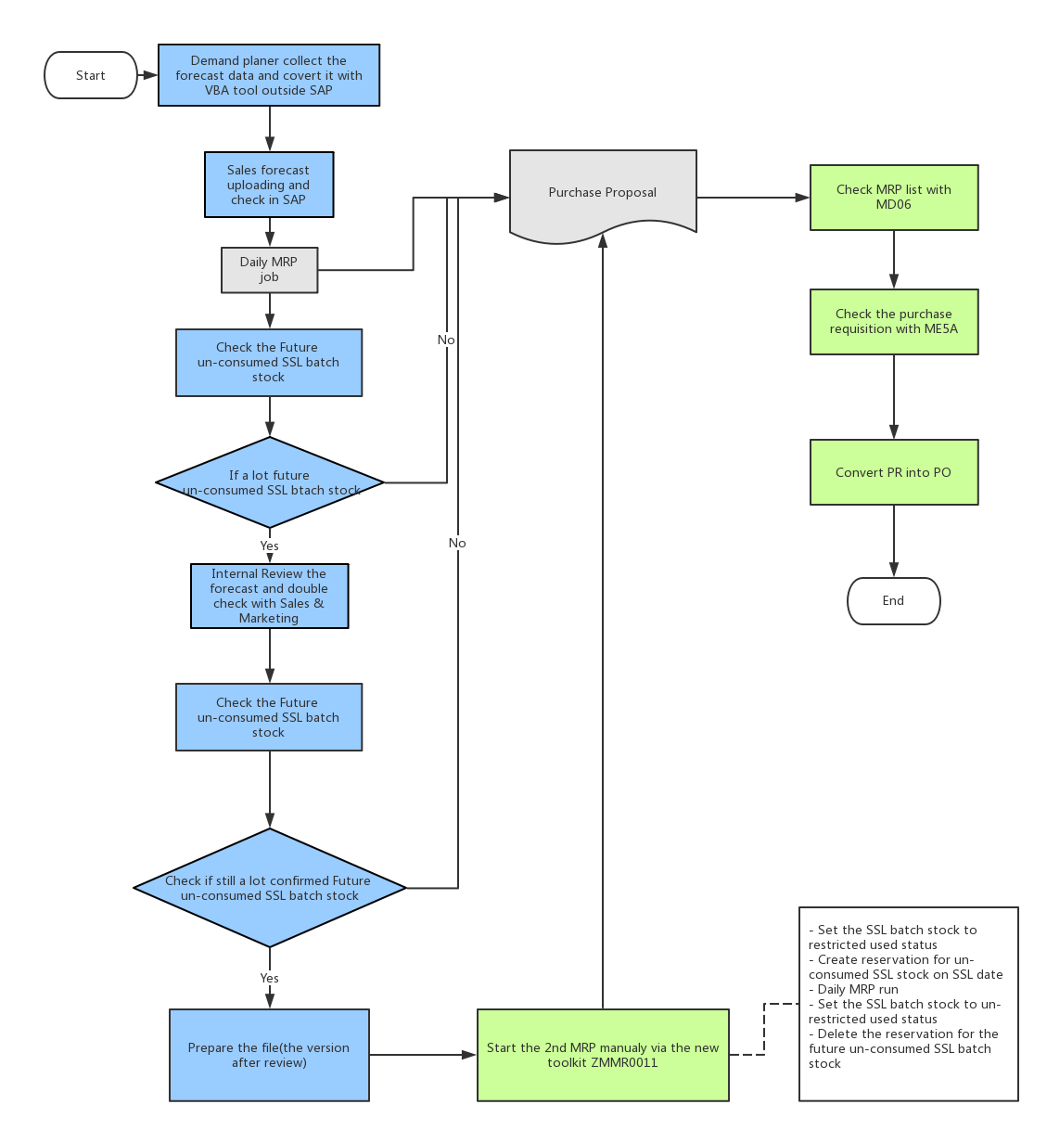
MRP in SINODIS
To be Solution: SAP MRP
Stock for planning
Current Available stock
* Future Un-Consumed Short Shelf Life(SSL) stock management
Forecast
Sales forecast
* Planned independent requirements
Open Purchase order
Open PO to third-party supplier
Open STO (stock in transit)
Open SO/DN
* These requirements will show in MRP list, but not take part in the MRP calculation. Only the cargoes leave the warehouse, it will consume the planned independent requirements.
As is Solution: Pipeline
Currently the purchaser in Sinodis use different excel tools for different brands:

Slide 4
Purchasing Planning– Material Requirement Planning in SINODIS
Proceed to input data updating :
saleable stock, in transit stock, forecasts, sales
Proceed to analyze inventory at risk: estimate and exclude SSL
Adjust qty to maximize container fulfilment :
On identified less critical skus
Calculate net required qty :
Estimated stock on hand at end of period to match safety stock
Adjust qty to supplier MOQ per sku :
Round unit per case or full pallet
1
Proceed to purchasing calculation
Safety stock – total ordering lead time – minimum purchase qty – specific schedule (national holiday/factory closure…)
2
3
Provide a purchase plan for the next ordering period
Confirm the production planning/stock availability
Make and adjustments and agree on sku and qty
Control the proforma invoice : qty and price per sku
Confirm and send the final a formal PO
2
Period -1
Period 0
Period 0
Period 0
Period 0
Purchase planning
Organize production planning - Organize shipment booking
Notes:
4

